Slide 1

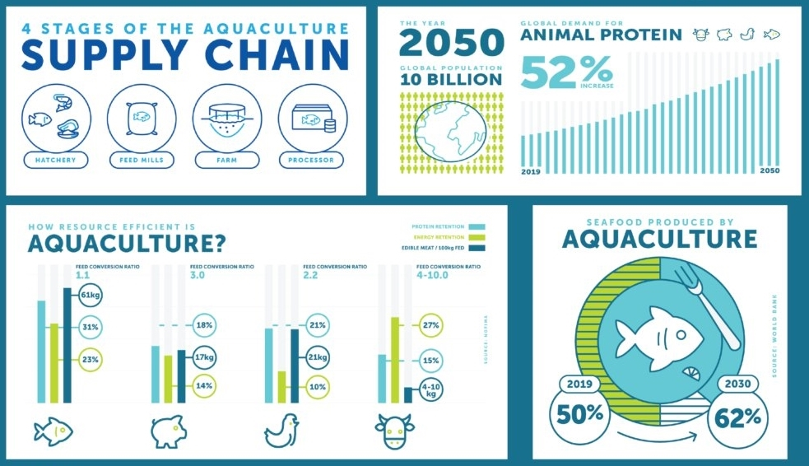
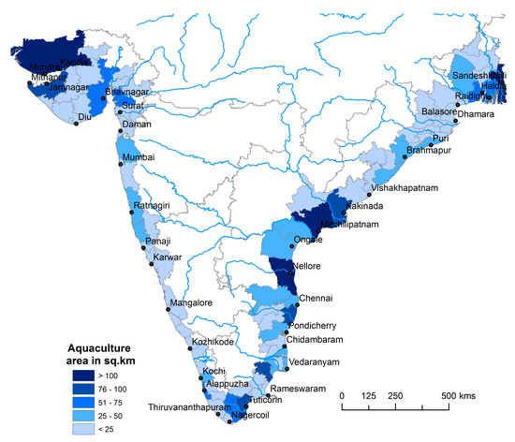
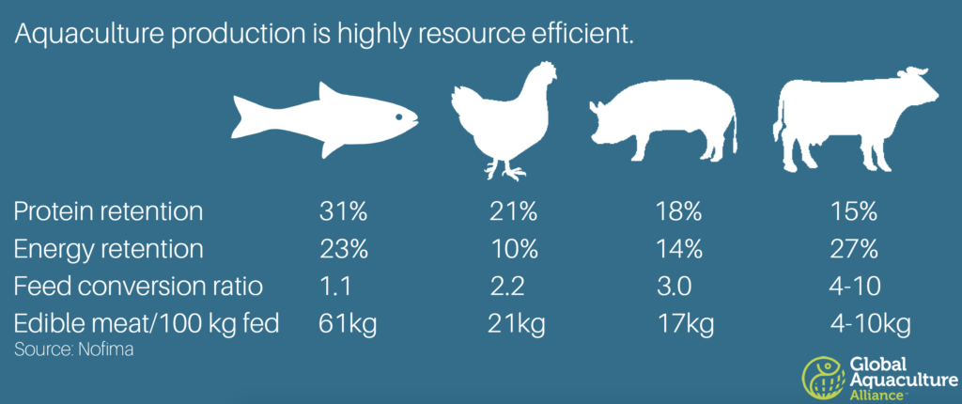
Introduction
Aquaculture is probably the fastest-growing animal production sector in the Asia Pacific region.
India is the 2nd largest producer of fish in the world and about 68% of India's fish comes from the aquaculture sector.
Government of India formulated and launched the Centrally Sponsored Scheme on “Development of Inland Fisheries and Aquaculture” under macro-management approach in States/UT’s during the 10th Plan. The total outlay approved for the entire 10th Plan period is Rs 135.00 crore [2].
Given that overfishing of our oceans and other natural resources is continuously increasing year over year, humans need alternate sources for seafood to feed the planet’s ever-growing population
Efficiency and growth rate of Aquaculture (Image 2 and 3 Source: Ref[3])
District-wise spatial distribution of aquaculture ponds along the districts on the Indian coast (Image Source: Ref[1])

Slide 2
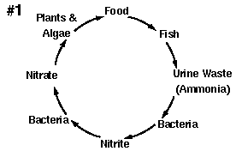
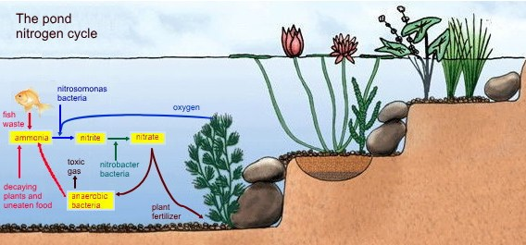
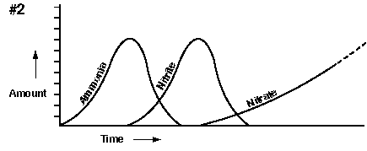
Nitrogen Cycle Pond
Pond water contains two major groups of substances:
Suspended particles made of non-living particles and very small plants and animals, the plankton.
Dissolved substances made of gases, minerals and organic compounds
The circle of increase of different Chemicals in water (Image Source: Ref[4]).
Pond Nitrogen Cycle (Image Source: Ref[5])

Slide 3
Problem Statement
How monitor the levels of toxic substances within the pond and report them to the fish breeder in time so that loss of fish population does not happen ?
Solution: To wirelessly monitor and report the parameters which are directly harming fish health.
The parameters are:
1) pH – Can be maintained via Lime.
2) Temperature of Water – Can be maintained via external Heating/Cooling.
3) Dissolved Oxygen – Can be maintained via external pumps.
4) Nitrite Concentration – Less toxic but an indicator that Nitrogen cycle isn’t working properly.
5) Nitrate Concentration - Calcium chloride or Electrochemical Methods.
6) Dissolved Ammonia – Constantly removed via biological filtration.

Slide 4
Design Objective And Constraints
Primary Objective: To make a device which can monitor water body parameters like dissolved oxygen, dissolved ammonia, temperature, pH, dissolved Nitrates and dissolved Nitrites and transmit their data to a range of about 5 kilometers.
1) The aforesaid device must not need replacement for very long period of time
2) Device must communicate to the fish breeder or the person responsible in case of drastically changing levels and provide timely updates preferably on a mobile.
3) Design of a multisensory node to cover the area.
4) Will completely work on energy harvesting (i.e. solar power), no external energy needed.

